Slide 1
WELCOME TO I.T.S.
BATCH:2021-2024
NAME: ARPIT SHARMA

Slide 2

HOSPITAL APPOINTMENT SYSTEM

Slide 3

PURPOSE OF HOSPITAL APPOINTMENT SYSTEM
The purpose of a Hospital Appointment System is to efficiently manage and coordinate patient appointments with healthcare providers..

Slide 4

SCOPE OF APPOINTMENT SYSTEM:
Appointment Scheduling: This is the core functionality where patients can book appointments with healthcare providers based on availability. It should allow for scheduling various types of appointments such as consultations, diagnostic tests, follow-ups, etc.
Patient Registration: Patients need to register with the hospital system before scheduling appointments. This involves collecting demographic information, medical history, insurance details, etc.
Appointment Reminders: Automated reminders via SMS, email, or phone calls help reduce no-show rates. Reminders can include appointment details, directions to the hospital, and any preparatory instructions.
Resource Allocation: The system should optimize resource allocation by considering factors such as provider availability, equipment availability (e.g., MRI machines), and room availability (e.g., consultation rooms, procedure rooms).

Slide 5

WHAT IS HOSPITAL APPOINTMENT SYSTEM ?
A hospital appointment system is a digital platform or software application designed to facilitate the scheduling and management of appointments for patients within a hospital or healthcare facility. It provides a centralized interface for patients, healthcare providers, and administrators to coordinate appointment bookings, manage availability, and optimize resource allocation.
Appointment Scheduling: Patients can book appointments with healthcare providers based on availability and their medical needs.
Provider Availability Management: The system maintains a database of healthcare providers, their specialties, schedules, and availability.
Patient Registration: Patients register with the hospital system, providing demographic information, medical history, and insurance details.
Appointment Reminders: Automated reminders are sent to patients to reduce no-show rates and ensure attendance.
Waitlist Management: preferred appointment slots and be notified of openings due to cancellations or rescheduling.

Slide 6

USER CHARACTERISTICS
User friendly system:
The Hospital Appointment systems are simple and easy to use for the Staff. The system provides online and offline storage of data. The system automatically updates and backups data. The system is flexible and can be adapted to the needs of the Hospital/Management.
Simplification of Staff duties:
The system allows the Staff to maintain a wide Records of Patient and their Medical History and when is the next Appointment is Scheduled.

Slide 7

Increased member engagement:
The system optimizes resource allocation by considering factors such as provider availability, equipment availability, and room availability. Administrators can generate reports and analyze data related to appointment scheduling trends, provider utilization, and patient satisfaction. Patients can provide feedback and reviews for their appointments, helping improve service quality.
Efficient data management:
The Hospital Appointment system software hosted from a Server platform is very efficient. The functions of Managing, Reporting, Cost and Security of Appointments are managed automatically and saved on the Server for reliable and secure operations.
7

Slide 8

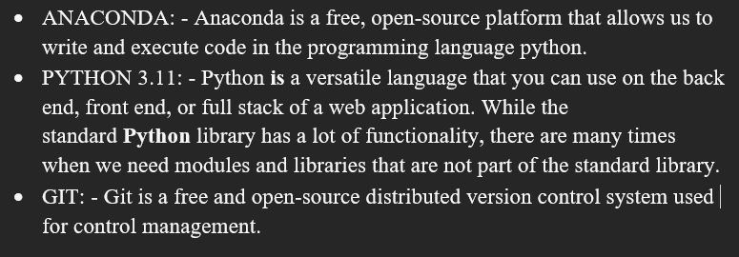
TECHNOLOGIES IS TO BE USED
from tkinter import *
import sqlite3
import tkinter
from tkinter.ttk import Separator
from tkinter import messagebox
conn = sqlite3.connect('database.db')
c = conn.cursor()
ids = []
number = []
patients = []

Slide 9


SOFTWARE AND HARDWARE INTERFACE
SOFTWARE INTERFACE
Software Interface
Front End Client: Git, Python 3.11.5, Operating System
(Windows, Linux, etc.)
Back End: Python
9

Slide 10
HARDWARE INTERFACE
Hardware Interface
Minimum Hardware Requirement
Client Side
Python 3.11.5 Processor RAM Disk Space
Pentium III at 500 MHz 4GB 3GB
Server Side
Git Pentium IV at 1.3GHz 4GB 4GB
VsCode Pentium IV at 1.3GHz 2GB 1GB(Excluding data size)

Slide 11

THANK YOU

